Slide 1
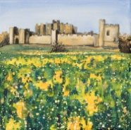
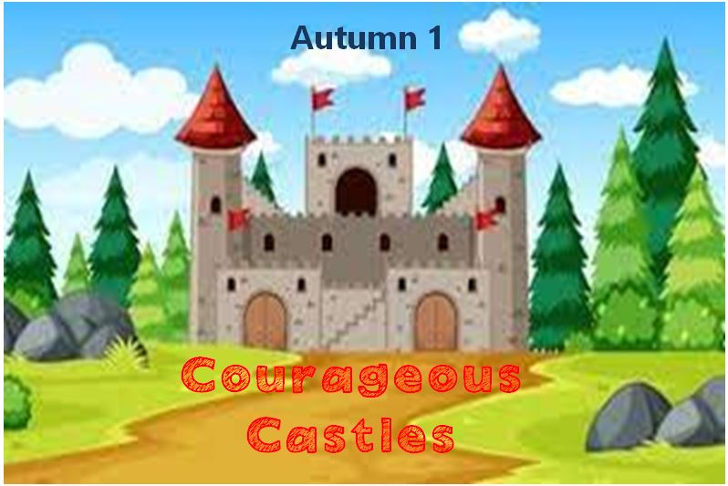
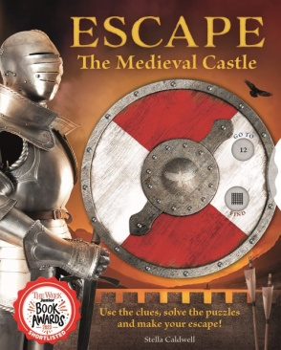

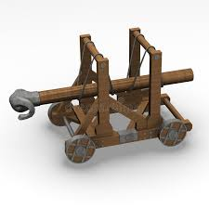
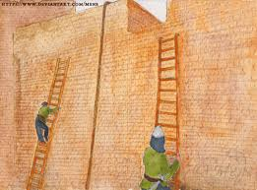
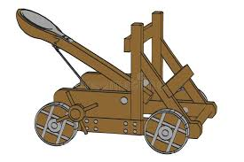
Dear Parents,
This half term our topic is all about castles, following on from KS1 to consider the successful defences, key features and where they are located around the country. They will visit Alnwick Castle, in contrast to Warkworth, learning about he Percy Family, it’s impenetrable barbican and life in medieval times. Meanwhile, they will focus on rocks and weathering in Science whilst designing a cast of arms in DT.
Mrs Chapman
Useful words
arrow loop – a narrow slip cut in the wall to fire arrows
bailey– a courtyard or area of land within the castle .
barbican – an outer defence of a castle before the gatehouse
battlement - a narrow wall built along the outer edge of the wall walk
curtain wall – outer wall of a castle linking towers and gates to form an enclosure
drawbridge– a heavy timber platform built to span a moat that could be raised
keep–the inner stronghold of a castle
moat– a ditch surrounding a castle, either filled with water or dry
portcullis – vertical sliding wooden grille with iron in front of a gateway
turret– small tower rising above usually used as a lookout point.
Our recommended read:
This half term ‘Escape the medieval castle’ will be available at the library or in school for you to borrow and share at home.
What mechanism is used to lift and lower a drawbridge?
Who lived in the keep , why does it have that name?
How did the arrow loops help protect against attack?
Why would the turrets be positioned on corners of the castle?
How was the barbican act as the first line of defence?
Autumn 1
Things to
remember:
Tuesday - PE day
Wednesday – Swimming
Thursday – Reading books changed Friday- Library
Friday 26th Sept European Day of Languages
Thurs 1st Oct Alnwick Castle Trip
Battering Ram
These would be wheeled up to the doors or the corners of a the castle to knock tem down.
Ladders
The invaders would lean the ladders up against the walls of the castle or fortress and climb up in order to infiltrate and attack
Catapult
This used a series of tightened ropes to cause a throwing arm to hurl a rock, stone or other projectile at a castle wall.

