Slide 1

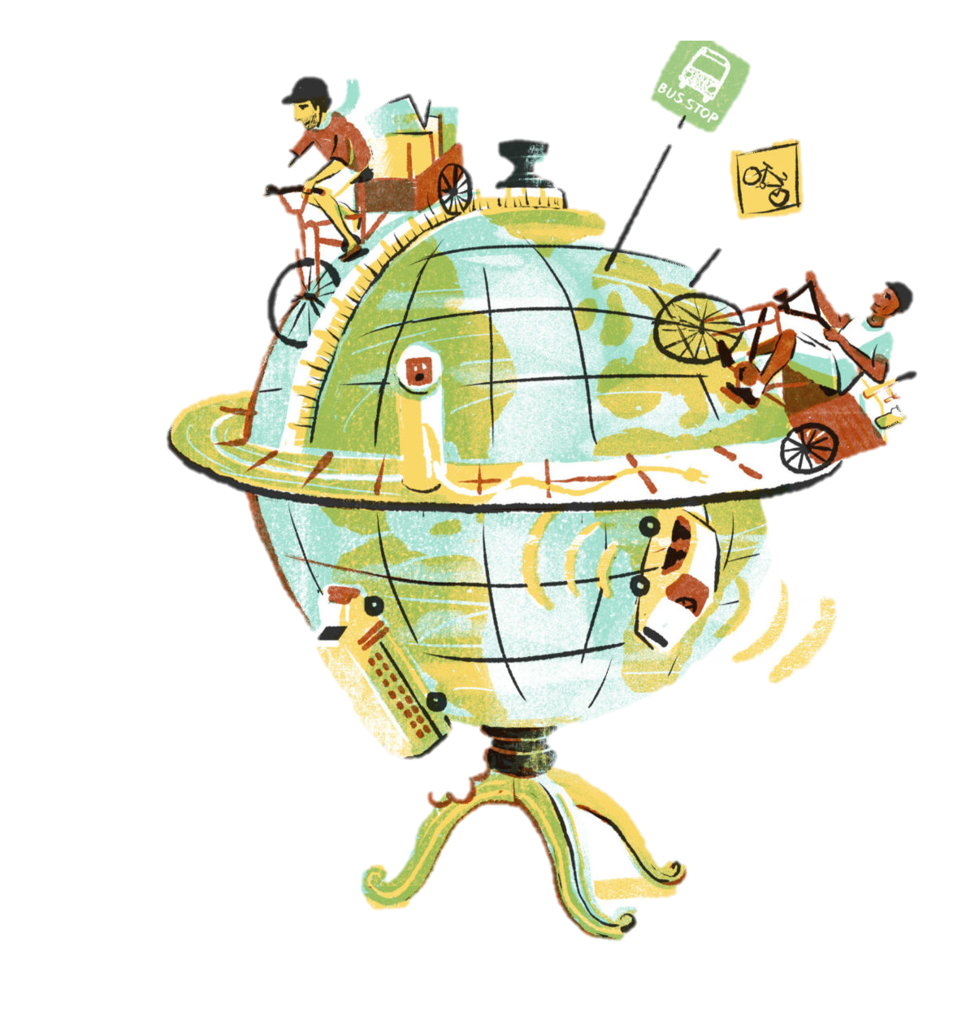
This half term our topic is Travellers Tales- All about the history of transport and getting from place to place. The children will explore lots of different types of transport and famous people with a link back to travelling.
History
Changes in living memory. Where appropriate, these should be used to reveal aspects of change in national life
Events beyond living memory that are significant nationally or globally (transport)
Significant historical events, people and places in their own locality.
KUW— Skills based objectives to focus on:
Continuity and change
• Discuss change and continuity in an aspect of life, e.g. holidays
Week 1
Topic- What is transport?
RE- What is special about a church?
PSHE- How can being kind or unkind effect others?
Computing- How can I paint on computers?
COUNTRYSIDE SHOW DAY
Week 2
Science – What do we need to survive?
Topic- Why do we live in Widdrington Station?
Topic – How have trains changed over time? Who is George Stephenson?
RE- Are all churches the same?
PSHE- What responsibilities do we have in school?
Computing- Can I use a computer to show data I have collected?
Week 3
Science –What are the best foods to eat?
Topic- TRANSPORT OVERTIME WORKSHOP
RE- What is special about a synagogue?
PSHE- How can we care for animals?
Computing- Can I use shapes and lines to make art?
Week 4
Science/ DT- Can we make a healthy meal?
Topic- How has transport changed over time? 1
Topic – How has transport changed over time? 2
RE- What is special about a mosque?
PSHE- What can harm our world? How can we care for the world?
Computing- How can I make my artwork unique?
Week 5
Science – What is the point in exercising?
RE- Where do people to go worship?
PSHE- How do people grow and change?
TRANSITION DAY & TRIP TO BEAMISH
CAREERS WEEK
Week 6
Science – Who is Poppy Okotcha?
Topic- Why did people want to travel?
RE- What is special about places of worship and how people act?
PSHE- How can we manage the change of moving classes?
Computing- How can I make my artwork unique?
Artis of the ½ term- Lowery
Science
To work scientifically;
-asking simple questions and recognising that they can be answered in different ways
-observing closely, using simple equipment
-gathering and recording data to help in answering questions.
Science:
Animals incl. Humans—basic needs of animals incl humans. Importance of human exercise, food and hygiene
Scientist (from spine)
Poppy Okotcha
Communication Language and Literacy
Stories from other cultures (focus on setting and description)- Zahra
Bigraphies- Little people, big dreams
SPAG:
Year 1
-Leaving spaces between words
-Joining words and joining clauses using and
-Beginning to punctuate sentences using a capital letter and a full stop, question mark or exclamation mark
-Using a capital letter for names of people, places, the days of the week, and the personal pronoun ‘I’
Word
Regular plural noun suffixes –s or –es
Sentence
How words can combine to make sentences
Punctuation
Introduction to capital letters, full stops, question marks and exclamation marks to demarcate sentences
Year 2
-Learning how to use both familiar and new punctuation correctly, including full stops, capital letters, exclamation marks, question marks, commas for lists and apostrophes for contracted forms and the possessive (singular)
-Sentences with different forms: statement, question, exclamation, command
-Expanded noun phrases to describe and specify
-The present and past tenses correctly and consistently including the progressive form
-Subordination (using when, if, that, or because) and co-ordination (using or, and, or but)
-Some features of written Standard English
Word
Formation of nouns using suffixes such as –ness, –er and by compounding. Formation of adjectives using suffixes such as –ful, –less
Sentence
Subordination (using when, if, that, because) and co-ordination (using or, and, but)
How the grammatical patterns in a sentence indicate its function as a statement, question, exclamation or command
Text
Correct choice and consistent use of present tense and past tense throughout writing
Punctuation
Use of capital letters, full stops, question marks and exclamation marks to demarcate sentences Commas to separate items in a list
Geography -
Geographical skills and fieldwork;
To use aerial photographs and plan perspectives to recognise landmarks and basic human and physical features devise a simple map; and use and
construct basic symbols in key
PSHE
How can we look after each other and the world around us?
Thinking about how animals need to be cared for and the responsibilities we have.
Careers week – recapping our learning so far on careers
Physical Development
Jumping 1
Jumping, landing, skipping, hopping and moving in different ways.
Team Building
Completing a challenge, understand and follow rules.
Mathematical Development
Length and Height + Mass and Volume Y1
Compare, describe and solve practical problems.
Time and Money Y1 unit
Compare, describe and solve practical problems.
Place Value within 100 Y1 unit
Count to and across 100, forwards and backwards, beginning with zero or 1, or from any given number.
Time Y2 unit
Tell and write the time to five minutes, including qauter past/to the hour and draw the hands on a clockface to show these times.
Statistics Y2 unit
Interpret and construct simple pictograms, tally charts, clock diargrams and simple tables. Ask and answer simple questions.
Position and direction Y2 unit
To use position and direction and movement vocabulary. Discuss turns including right angles, quarter, half and three-quarter turns clockwise and anti-clockwise.
Phonics and reading
Year 1 will continue with Read write Inc daily as well as hearing adult lead daily story time following the favourite five scheme. Children in year 2 will be working on the RWI programme or guided reading.
Children will also have access to a range of ‘topic books’ that link with farming in the class library.
On a Friday the children will go to the local library and take home a book each week.
The Arts
DT
To design, make an evaluate a product.
To learn about wheels and axis and how objects can move with a link to the transport theme of the topic.
Artist (from spine)
Lowry
RE
What makes some places sacred to believers?
The children will learn about churches, synagogues and mosques.
All lessons are planned from the locally agreed syllabus and uses understanding Christianity as a resource.
Computing–
Teach computing- Y2 creating media – digital photography
Skills: Use technology purposefully to create digital content
Esafety:
Online bullying + SID (DL)
Y1 Skills: I can explain simple guidance for using technology in different environments and settings.
Educational enhancement
This half term we will be experience a blast from the past with a work shop all about transport overtime. We will learn about how transport has evolved and the important inventors that made this possible as well as some super drama about Amelia Earheart.

