Slide 1




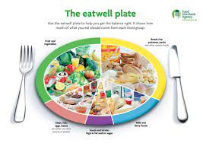
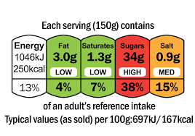
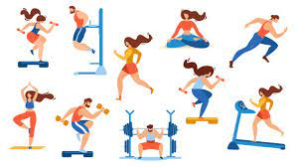
Dear Parents,
This half term our topic allows us to explore an area of the world in another continent. They will find out about what it is like to holiday in Mexico and the human and physical features of the Mayan cities and civilisation. Also, they will find out the mega structure Mega structure and how the civilisation both developed and declined. Best of all, after learning about nutrition they will design and make their own healthy tortilla wraps and compare the Mayan diet to our won.
Mrs Chapman
Useful words
cacao – seeds that the Maya used to make chocolate
Chichen Itza– a Mayan pyramid
codex– Book created by the Mayans
glyphs– symbols used in the Mayan writing system
Hero Twins– a major story in Maya mythology
Huipil– A traditional garment worn by Maya women
kukulcan – the serpent God of the Maya
maize– a plant like sweet corn that is grown in Central America
Solstice – the time when the sun reaches its maximum or minimum length
Tikal– one of the most powerful city states in Mayan times
Our recommended read:
This half term ‘The Chocolate Tree’ by Linda Lowrey and Richard Keep will be available at the library or in school for you to borrow and share at home.
What special things happens to Chichen Itzaat summer and winter solstice?
What is special about the huipil clothing?
Could you write a message using glyphs?
Why was maize such a vital part of the Mayan diet?
How can cacoa seeds be used to make chocolate?
Spring 1
Things to
remember:
Monday– Spellings
Tuesday - PE with NUFC
Wednesday – Forest School and PE ***Not swimming***
Thursday – Reading books changed
Friday- Library
Fri 6th Feb NSPCC Numbers Day
Tues 10th Feb Safer Internet Day
Fri 13th Feb Computing open afternoon
Food groups
As part of the eat well guide it is recommended that our meals should have balance between all different food groups with a larger focus on fruit, vegetables and carbohydrates
Food labels
These food labels can be very useful for giving you an idea to the nutritional value in each item. The traffic light visually shows you where there are benefits to your healthy diet.
Exercise
Your heart and other muscles are always very busy keeping you healthy and active. Exercise has many benefits to keep these muscles working their best as well as putting you in a good mood.

