Slide 1




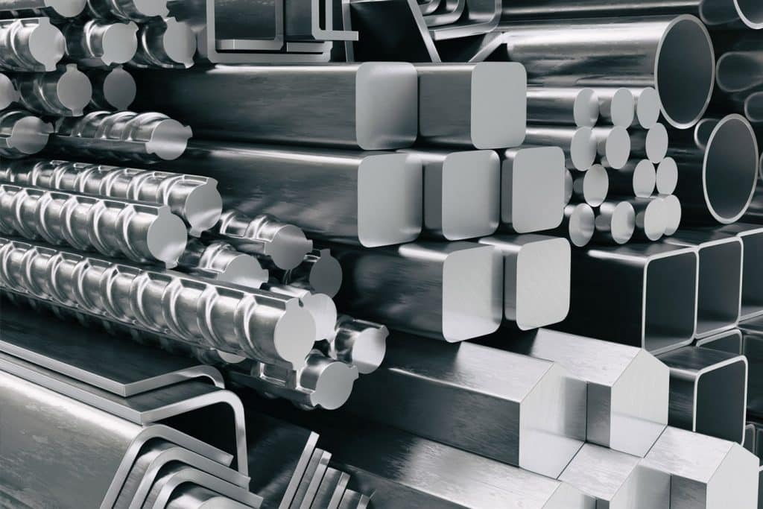
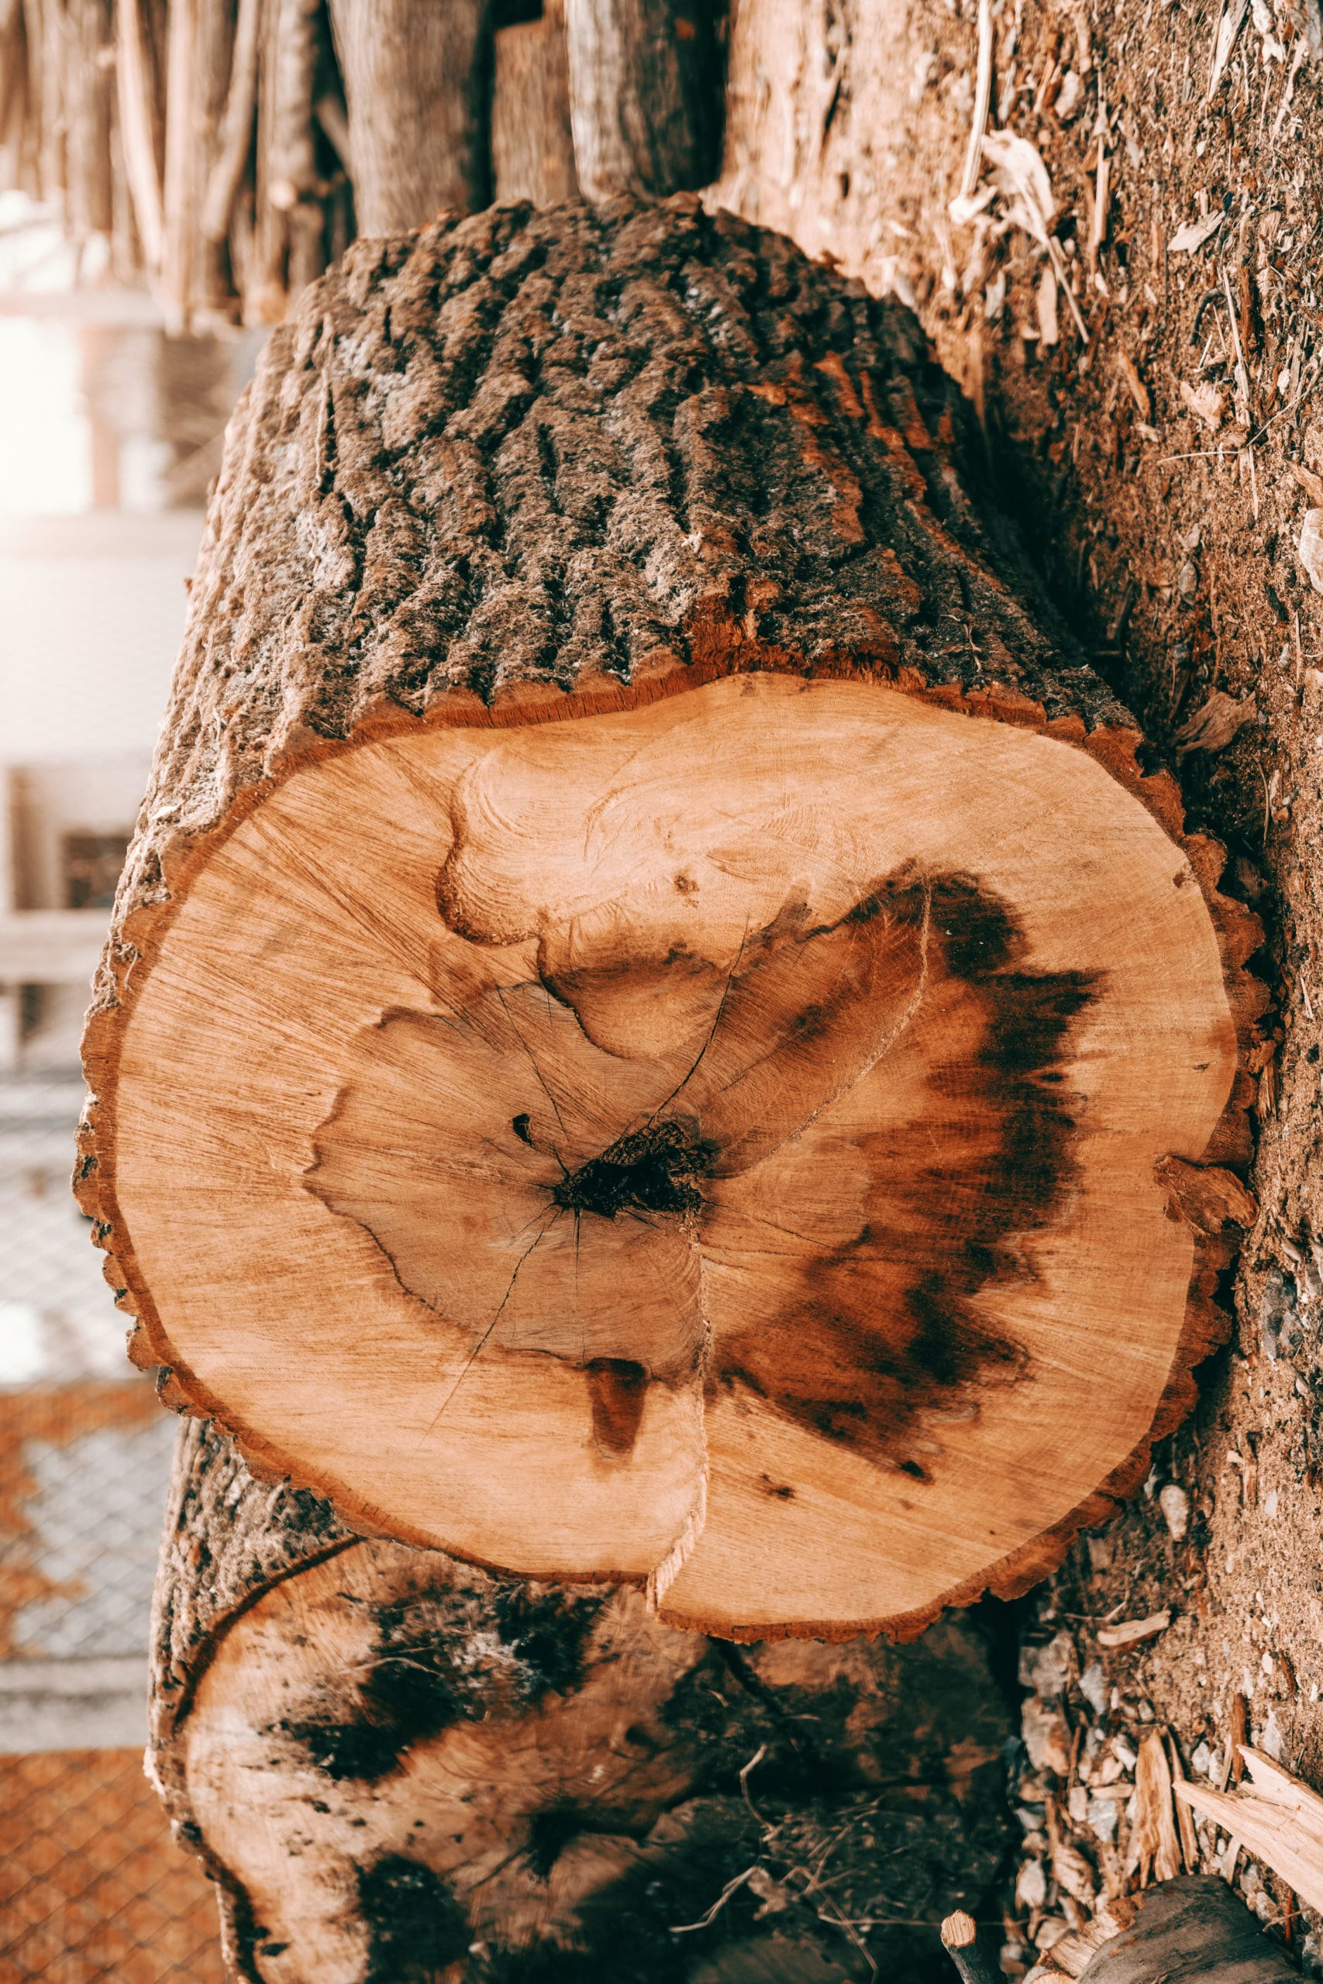
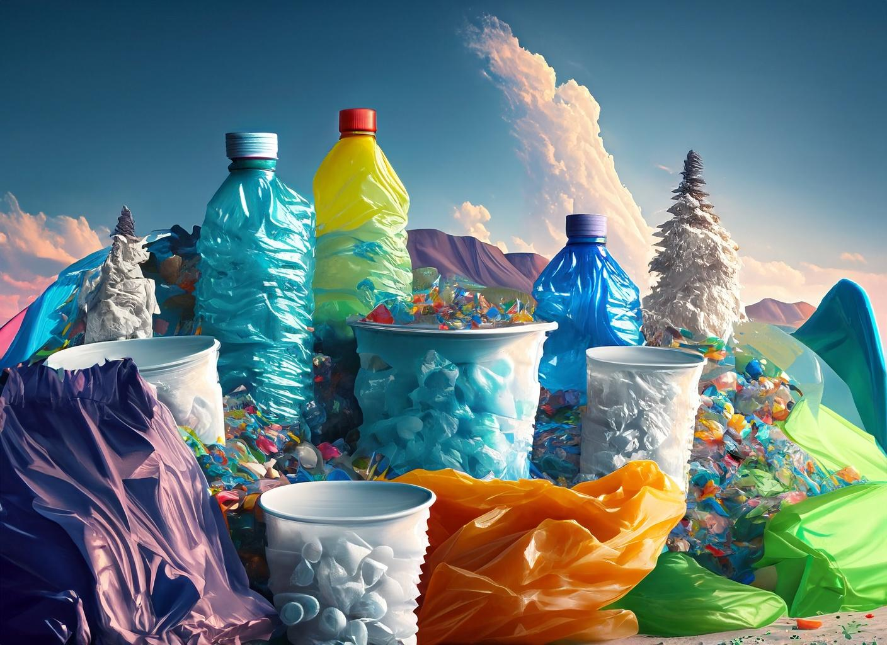
Dear Parents,
Welcome back! We are so excited to kick off a new school year with a fab topic where the children will be investigating and exploring everyday materials.
The children will be doing a lot of outdoor learning this half term so if you haven’t already done so, please send some wellies into school.
Miss Darlow and Miss Conroy
Useful words
material- What something is made out of.
properties- The qualities of a material- what its like.
waterproof- repels water and keeps things dry.
absorbent- soaks water up.
transparent- you can see through it.
opaque- you can’t see through it.
Environment- The world around us and animals habitats.
Fair test- When we are being scientists we need to make sure we conduct a fair test to make sure our findings are accurate.
Our recommended read:
This half term we are learning all about materials. We will receive lots of books from the library service but this is a great one ‘Everyday materials.’
I suggest if you want to have fun get the book ‘101 great science experiments’ its super fun!
Can you think of anything in your house made of wood?
What things in your house are opaque?
Can you think of anything in your house made of metal?
Can you find anything in your house that is transparent?
What materials can you find in your own home?
Autumn 1
Monday- PE DAY-
Wear your PE kit to school
Tuesday- PE DAY-
Wear your PE kit to school
Wednesday –
Thursday Reading book change day!
Friday- Family worship & Library day.
wood
Wood is a natural material that comes from trees.
Metal
Metal is strong material and comes in many different forms and can be made into different things.
Plastic
Plastic is a man made material and there is a big movement to reduce the use of plastic.
Things to remember:

