Slide 1
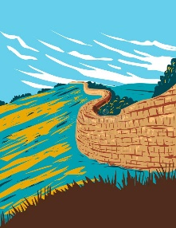
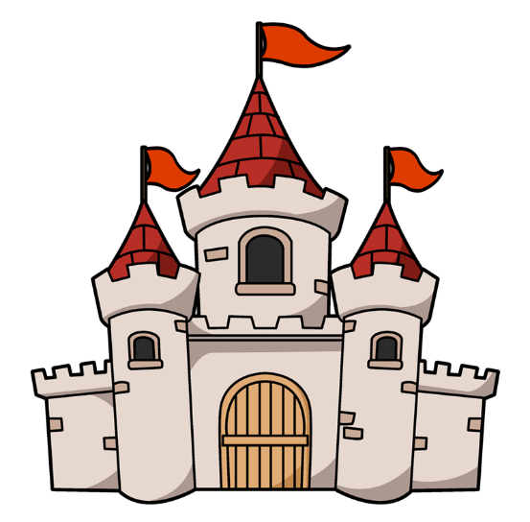
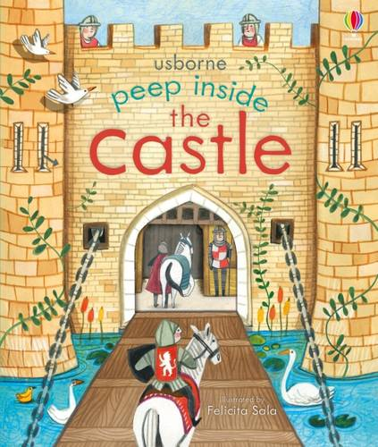
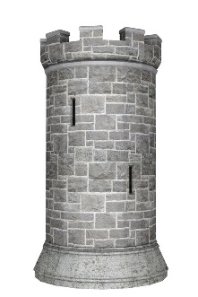
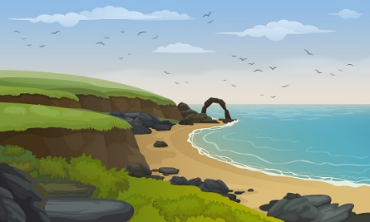
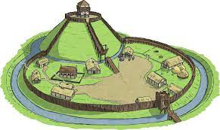
Dear Parents,
This half term our topic is all about castles. The children will be learning about why castles were built and why we have so many in Northumberland. They will learn the features of a castle and how they were defended against invaders. We also have Arts week and the coronation. Busy half term!
Miss Darlow
Useful words
Keep- The strongest part of the castle and often where the lord lived.
Location – Where a place is and what it looks like.
Motte- A Hill.
Moat – A deep, wide trench around a castle- it can be filled with water.
Bailey- the super strong wall around the a castle.
Defence- Protection from attack.
Battlements – A wall at the top of a castle with open spaces to shoot through.
Medieval- A time in history- long ago!
Our recommended read:
This half term ‘Peep inside the castle’ is a recommended read. It’s a great book with fold down flaps and lots of great facts.
Where is our closest castle?
Where do you find castles?
What materials are castles made from? Why?
Would you like to live in a castle?
Why does Northumberland have so many castles?
Summer1
Beech Class
Monday- PE, spelling test
Tuesday- PE
Wednesday –
Thursday – forest school
Friday- Family worship
Coast Line
Castles are often found alone the coast. This is one of the reasons we have so many in Northumberland.
Things to remember:
Our castles trip will be in summer 2 due to SATS.
Tower
Many castles have towers or had towers added on later. Why do you think this was?
Motte and bailey castle
A motte and bailey castle is one of the first types of castle designs and was incredibly popular.

